Slide 1
Singing voice conversion for Ukrainian folk song

Slide 2
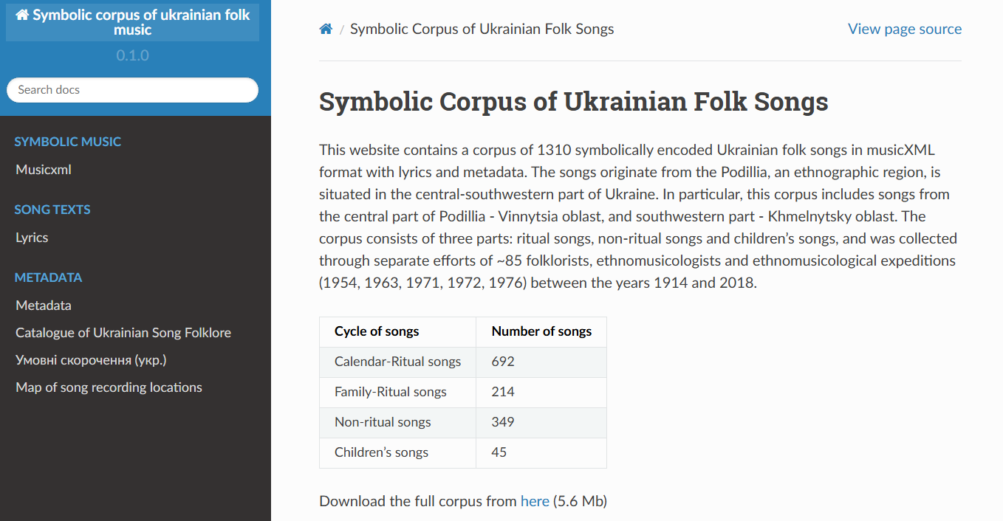
~1300 songs in symbolic format

Slide 3

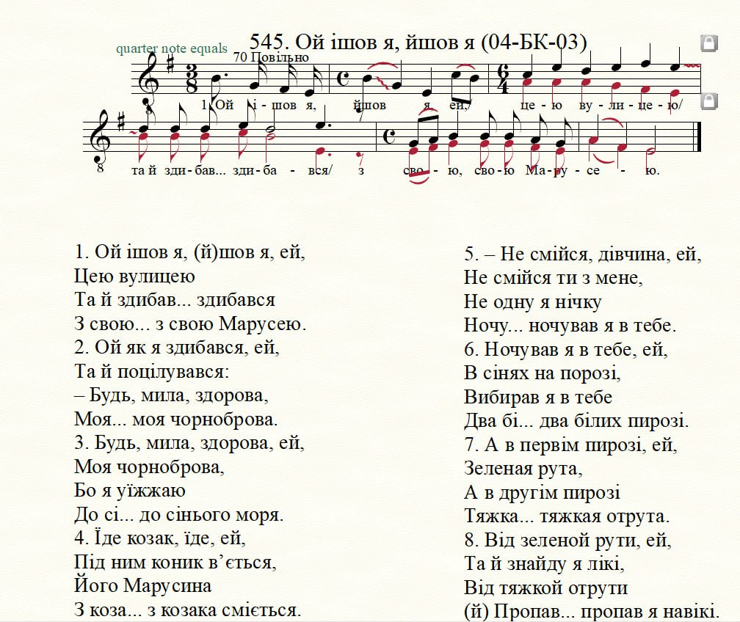
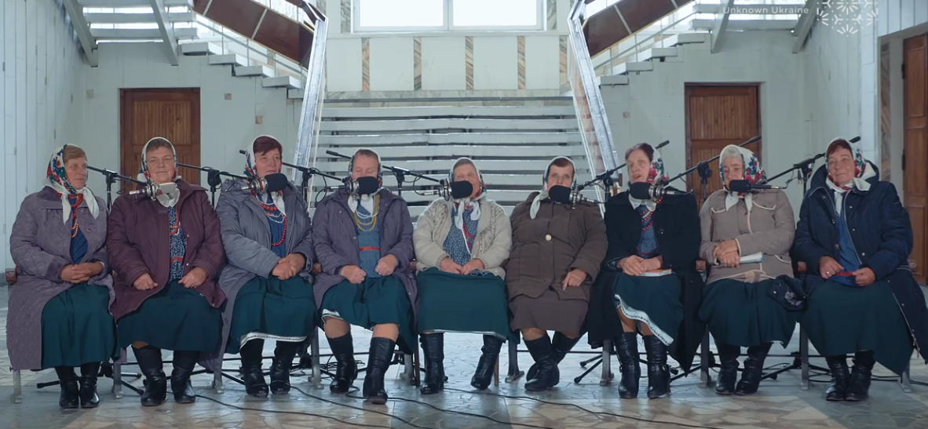
Few songs have recordings from other sources
Polyphony project

Slide 4
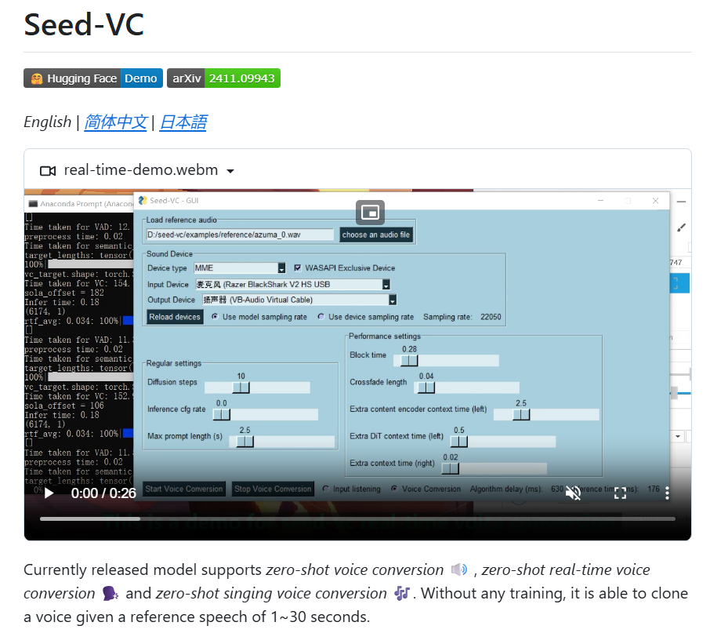
We will synthesize vocals + use voice cloning

